Slide 1

GaiaCoin when ESG meets Web 3
Environmental, Social, Governmence
TEAM: add names
SDX Challenge
Notes:
Explain right away ESG

Slide 2
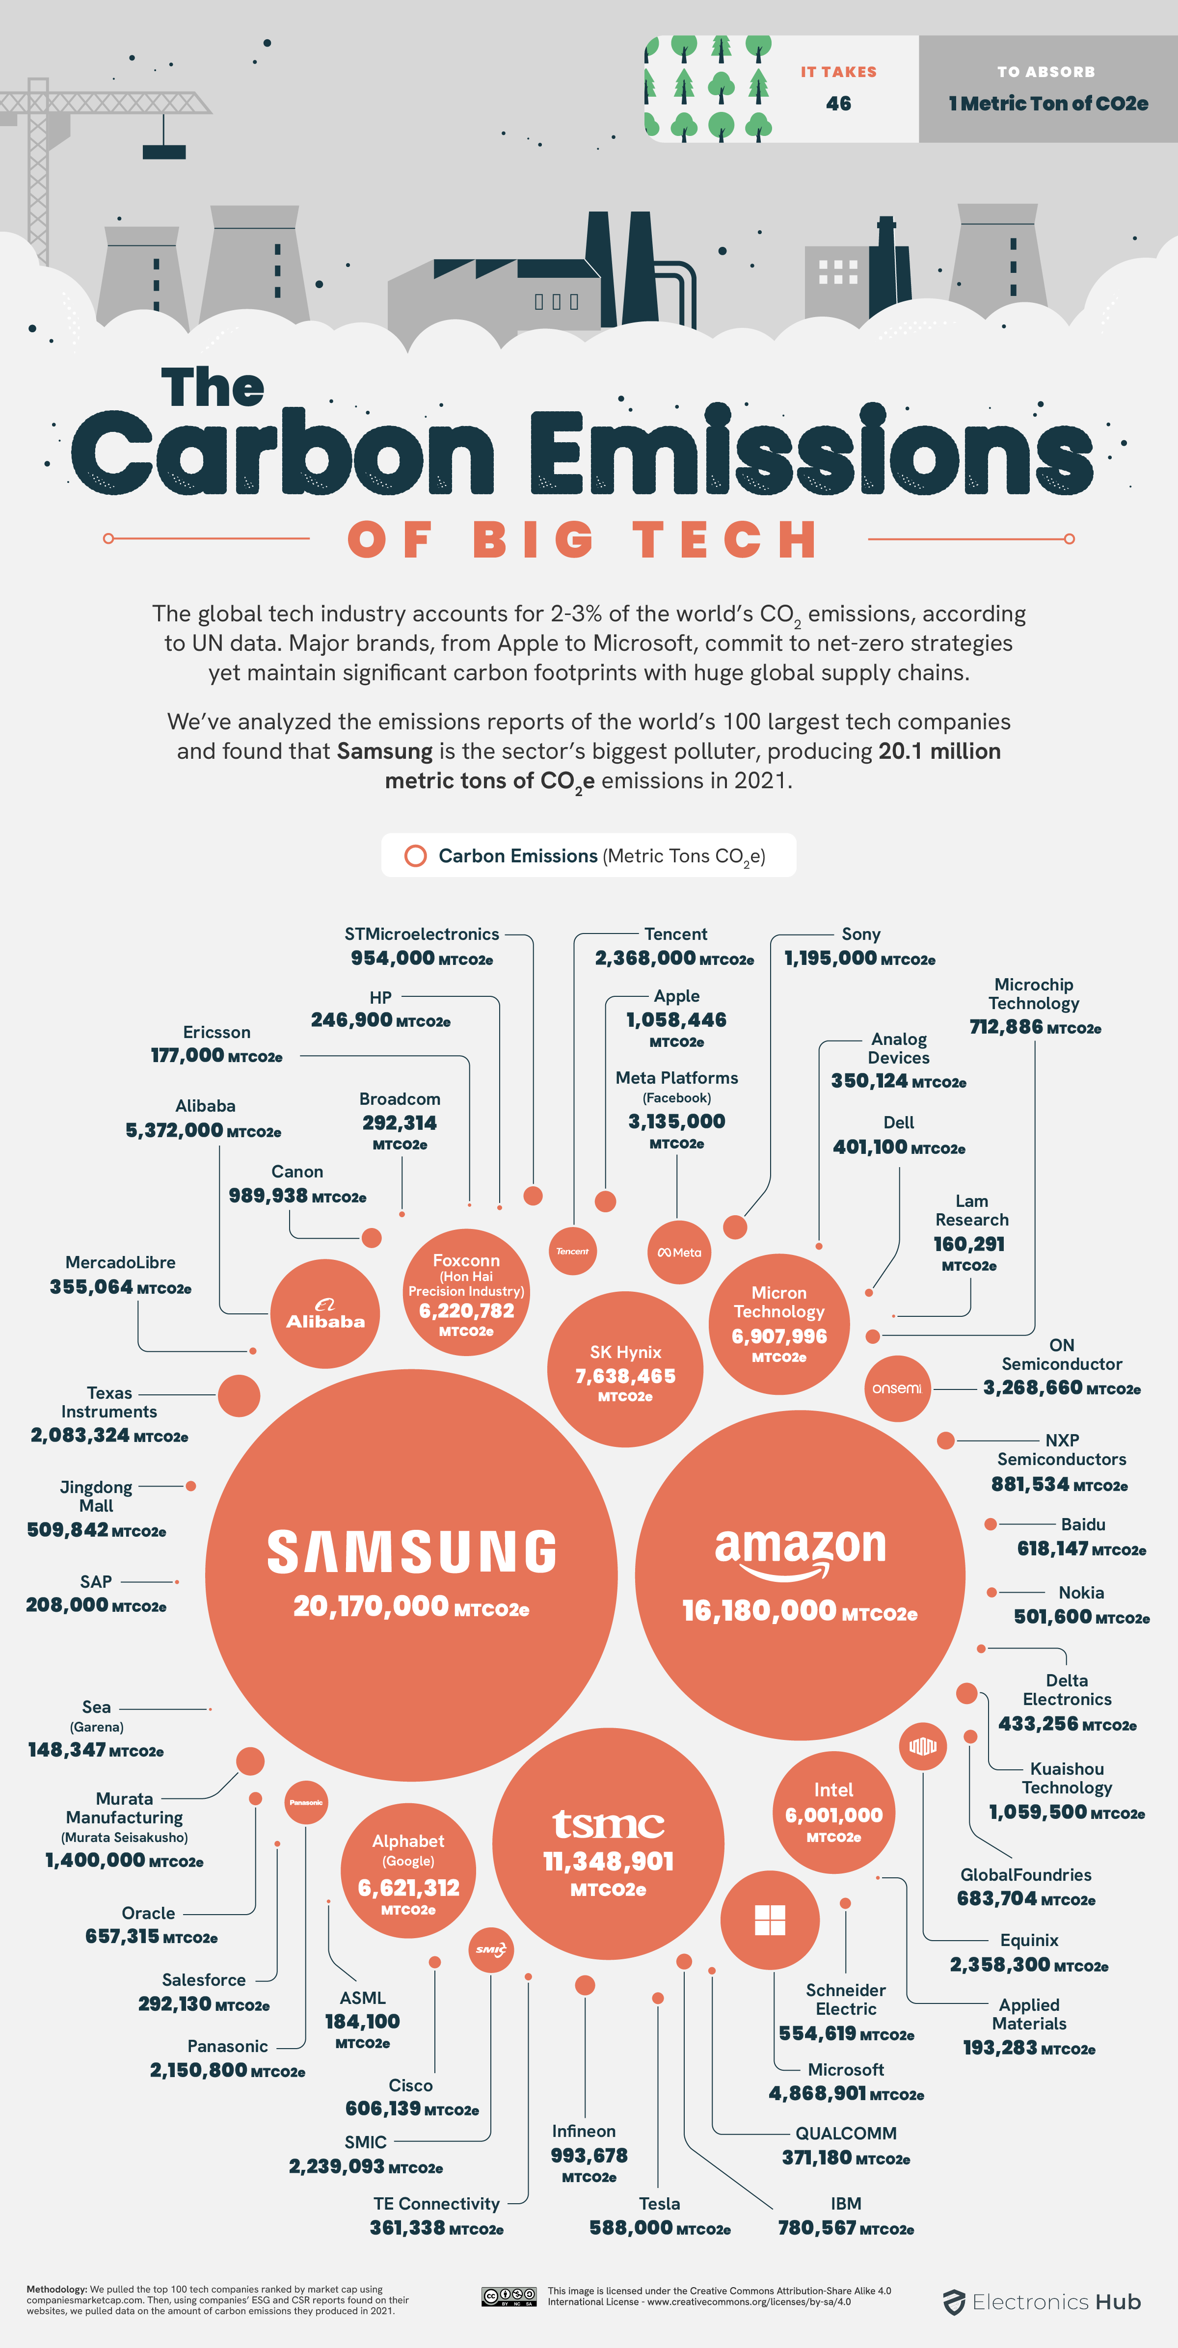
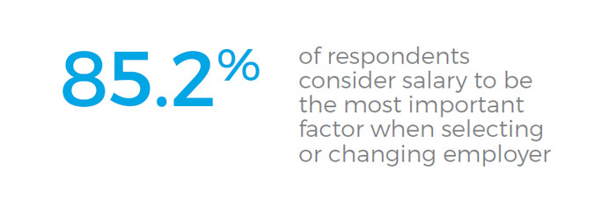
How do you select employer?
What about their environmental impact?

Slide 3
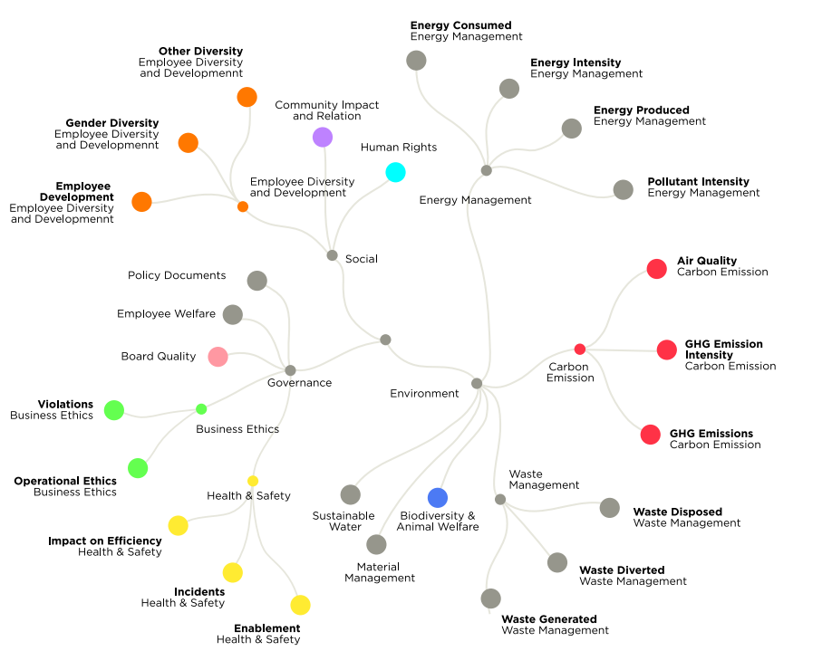
ESG indicators
Notes:
Source: Challenges in ESG data gathering | Accenture (08/06/2022)

Slide 4
Goal: unite stakeholders to promote Net Zero using GaiaCoin as a KPI
competes
competes
Competitors
Company A
Company B
Company C
service
Exchange Platform
SDX
member
Incentive
GaiaCoin
Representative body
promotes
Government / Society
Base

Slide 5



GaiaCoin – a token as a new KPI for ESG competitions in the era of Web 3
Offchain data
Participants
Issuer
Actions A
Company A
GaiaCoin
Actions B
Company B
Actions C
Company C
Technology
1
Chainlink
Smart contract
2
Web 2-based ESG facts are imported via chainlink
ESG actions are used to evaluate performance and trigger smart contracts

Slide 6
Demo

Slide 7

Bring ESG via BlockChain to Visibility & Enthusiasm
Environmental, Social, Governmence

Slide 8
GaiaCoin team
QR Jin Cao
QR Silvia Götti
QR Mihaela Brankova
QR Daria Zorina
QR Lilia Cojocaru

Slide 9


How do you help the earth?
How do you select employer?

